Slide 1

Threads and Networking
Maxim Leykin (maxim.leykin@gmail.com)

Slide 2

Approaches to Work in Background
Main thread in Android application is always UI thread.
All operations longer than several seconds MUST be on separate threads in order not to freeze UI.
You can do this using the following:
Thread
AsyncTask
HandlerThread
Service
Attempt to perform network request from UI thread will cause NetworkOnMainThreadException.

Slide 3
Approaches to work in Background. Threads.

Slide 4
Plain Threads. Creation
private TextView mTextTest; protected void onCreate(Bundle savedInstanceState) { ... new Thread() { public void run() { final String response = //long operation; runOnUiThread(new Runnable() { public void run() { mTextTest.setText(response); } }); } }.start(); }

Slide 5
Plain Threads. Access to UI elements
It is not possible to access UI elements from thread different than the thread where those elements have been created. Otherwise you’ll get CalledFromWrongThreadException. There are 3 possible approaches to resolve this:
View#post
Activity#runOnUiThread
Handler

Slide 6
Plain Threads. View#post
protected void onCreate(Bundle savedInstanceState) {
super.onCreate(savedInstanceState);
setContentView(R.layout.activity_main);
textView = (TextView)findViewById(R.id.hello);
WorkingClass workingClass = new WorkingClass();
Thread thread = new Thread(workingClass);
thread.start();
}
class WorkingClass implements Runnable{
public void run() {
textView.post(new Runnable() {
@Override
public void run() {
textView.setText("The job is done!");
}
});
}
}

Slide 7
Plain Threads. Activity#runOnUIThread
protected void onCreate(Bundle savedInstanceState) {
super.onCreate(savedInstanceState);
setContentView(R.layout.activity_main);
textView = (TextView)findViewById(R.id.hello);
WorkingClass workingClass = new WorkingClass();
Thread thread = new Thread(workingClass);
thread.start();
}
class WorkingClass implements Runnable{
public void run() {
MainActivity.this.runOnUiThread(new Runnable() {
@Override
public void run() {
textView.setText("The job is done!");
}
});
}
}

Slide 8
Plain Threads. Handlers & Messages
Create Handler object inside UI thread
Override handleMessage() method
Create new non-UI thread
In non-UI thread get Message object via method obtainMessage()
final Message obtainMessage()
final Message obtainMessage(int what, Object obj)
final Message obtainMessage(int what, int arg1, int arg2)
final Message obtainMessage(int what, int arg1, int arg2, Object obj)
final Message obtainMessage(int what)
Send message to the Handler using one of Handler using one of the following methods:
boolean sendMessage(Message msg) – to the end of the queue
boolean sendMessageAtFrontOfQueue(Message msg) – to the beginning of the queue
boolean sendMessageAtTime(Message msg, long uptimeMillis) – to the end of the queue at the exact time
boolean sendMessageDelayed(Message msg, long delayMillis) – to the end of the queue with delayMillis delay

Slide 9
Plain Threads. Handlers & Messages
Message object contains the following :
public int arg1 - arg1 and arg2 are lower-cost alternatives to using setData() if you only need to store a few integer values.
public int arg2 - arg1 and arg2 are lower-cost alternatives to using setData() if you only need to store a few integer values.
public Object obj - An arbitrary object to send to the recipient.
public Messenger replyTo - Optional Messenger where replies to this message can be sent.
public int what - User-defined message code so that the recipient can identify what this message is about.
Sample: HandlerSample

Slide 10
Plain Threads. Tips & Tricks.
Tips & Tricks
1. Have a strategy for dealing with configuration changes
Handle Activity start/stop
Interrupt/quit the thread and save work in onDestroy (or onStop)
Resume work in onCreate (or onStart) of the new activity.
2. Minimize the chance of uninterruptible work
Fully close/abort socket transactions to stop connects and reads
Check for thread interruption in CPU-bound loop
3. Prevent Activity leaks
Force a decoupling of Activity/View instances with Thread instances
If needed, find a way to do UI updates

Slide 11
Plain Threads. Pros and Cons.
Pros:
They can do everything you want to do
Cons:
Creation time
Inner classes have outer references that may leak memory
Don’t handle configuration changes
Don’t facilitate UI updates
When to use:
You need full control over threading behavior
You fully understand the concurrency behavior of the entirety of your app
Avoid managing threads directly in your activities unless you absolutely know what you’re doing!

Slide 12
Approaches to work in Background. AsyncTasks.

Slide 13
AsyncTasks
class TestTextLoader extends AsyncTask<Void, Integer, String> { @Override protected void onPreExecute() {} @Override protected void onPostExecute(final String result) { mTextTest.setText(result); } @Override protected String doInBackground(final Void... params) { String result = //long operation; return result; }
}
AsyncTask enables proper and easy use of the UI thread. This class allows you to perform background operations and publish results on the UI thread without having to manipulate threads and/or handlers. An asynchronous task is defined by a computation that runs on a background thread and whose result is published on the UI thread. An asynchronous task is defined by 3 generic types, called Params, Progress and Result, and 4 steps, called onPreExecute, doInBackground, onProgressUpdate and onPostExecute.

Slide 14
AsyncTasks. Generic Types.
The three types used by an asynchronous task are the following:
Params, the type of the parameters sent to the task upon execution.
Progress, the type of the progress units published during the background computation.
Result, the type of the result of the background computation.
Not all types are always used by an asynchronous task. To mark a type as unused, simply use the type Void:
private class MyTask extends AsyncTask<Void, Void, Void> { ... }

Slide 15
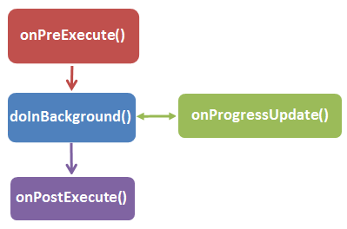
AsyncTasks. 4 steps of execution.
When an asynchronous task is executed, the task goes through 4 steps:
onPreExecute(), invoked on the UI thread before the task is executed. This step is normally used to setup the task, for instance by showing a progress bar in the user interface.
doInBackground(Params...), invoked on the background thread immediately after onPreExecute() finishes executing. This step is used to perform background computation that can take a long time. The parameters of the asynchronous task are passed to this step. The result of the computation must be returned by this step and will be passed back to the last step. This step can also use publishProgress(Progress...) to publish one or more units of progress. These values are published on the UI thread, in the onProgressUpdate(Progress...) step.
onProgressUpdate(Progress...), invoked on the UI thread after a call to publishProgress(Progress...). The timing of the execution is undefined. This method is used to display any form of progress in the user interface while the background computation is still executing. For instance, it can be used to animate a progress bar or show logs in a text field.
onPostExecute(Result), invoked on the UI thread after the background computation finishes. The result of the background computation is passed to this step as a parameter.

Slide 16
AsyncTasks. Cancelling a task.
A task can be cancelled at any time by invoking:
public final boolean cancel (boolean mayInterruptIfRunning)
Attempts to cancel execution of this task. This attempt will fail if the task has already completed, already been cancelled, or could not be cancelled for some other reason. If successful, and this task has not started when cancel is called, this task should never run. If the task has already started, then the mayInterruptIfRunning parameter determines whether the thread executing this task should be interrupted in an attempt to stop the task.
Calling this method will result in onCancelled(Object) being invoked on the UI thread after doInBackground(Object[]) returns. Calling this method guarantees that onPostExecute(Object) is never invoked. After invoking this method, you should check the value returned by isCancelled() periodically from doInBackground(Object[]) to finish the task as early as possible.

Slide 17
AsyncTasks. Cancelling a task.
A task can be cancelled at any time by invoking:
public final boolean cancel (boolean mayInterruptIfRunning)
Attempts to cancel execution of this task. This attempt will fail if the task has already completed, already been cancelled, or could not be cancelled for some other reason. If successful, and this task has not started when cancel is called, this task should never run. If the task has already started, then the mayInterruptIfRunning parameter determines whether the thread executing this task should be interrupted in an attempt to stop the task.
Calling this method will result in onCancelled(Object) being invoked on the UI thread after doInBackground(Object[]) returns. Calling this method guarantees that onPostExecute(Object) is never invoked. After invoking this method, you should check the value returned by isCancelled() periodically from doInBackground(Object[]) to finish the task as early as possible.
protected void doInBackground(Void... params) {
try {
for (int i = 0; i < 5; i++) {
Thread.sleep(1);
if (isCancelled()) return null;
}
} catch (InterruptedException e) {
Log.d(LOG_TAG, "Interrupted");
e.printStackTrace();
}
return null;
}

Slide 18
AsyncTasks. Threading Rules.
There are a few threading rules that must be followed for this class to work properly:
The AsyncTask class must be loaded on the UI thread. This is done automatically as of JELLY_BEAN.
The task instance must be created on the UI thread.
execute(Params...) must be invoked on the UI thread.
Do not call onPreExecute(), onPostExecute(Result), doInBackground(Params...), onProgressUpdate(Progress...) manually.
The task can be executed only once (an exception will be thrown if a second execution is attempted.)

Slide 19
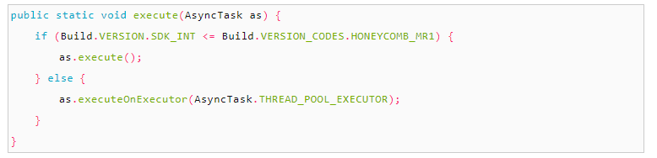
AsyncTasks. Order of Execution
Order of execution
When first introduced, AsyncTasks were executed serially on a single background thread. Starting with DONUT, this was changed to a pool of threads allowing multiple tasks to operate in parallel. Starting with HONEYCOMB, tasks are executed on a single thread to avoid common application errors caused by parallel execution. If you truly want parallel execution, you can invoke executeOnExecutor(java.util.concurrent.Executor, Object[]) with THREAD_POOL_EXECUTOR.

Slide 20
AsyncTasks. Possible Issues.
When the Activity is restarted, your AsyncTask’s reference to the Activity is invalid, so onPostExecute() will cause application to crash, and an exception similar to these ones will be thrown: java.lang.IllegalArgumentException: View not attached to window manager, or Activity has leaked window com.android.internal.policy….
If we continue processing a background task after the Activity has finished, we are probably doing unnecessary work, and therefore wasting CPU and other resources (including battery life), which could be put to better use.
Any object references held by the AsyncTask will not be eligible for garbage collection until the task explicitly nulls those references or completes and is itself eligible for garbage collection. Since our AsyncTask probably references the Activity or parts of the View hierarchy, we can easily leak a significant amount of memory in this way. A common usage of AsyncTask is to declare it as an anonymous inner class of the host Activity, which creates an implicit reference to the Activity and an even bigger memory leak.

Slide 21
AsyncTasks. Tips & Tricks.
A bit of job to make execution memory-safe
Make Thread/AsyncTask subclass static (if inside the Activity) or a standalone class so they do not retain the implicit reference to the parent Activity. Instead, an Activity reference is explicitly passed to the task.
In the constructor, pass in the Activity object and use a WeakReference to hold it
Check the Activity WeakReference contents for null on each access
Remember to end thread execution no later than onDestroy ()
Sample: AsyncTaskSample

Slide 22
Approaches to work in Background. HandlerThreads.

Slide 23
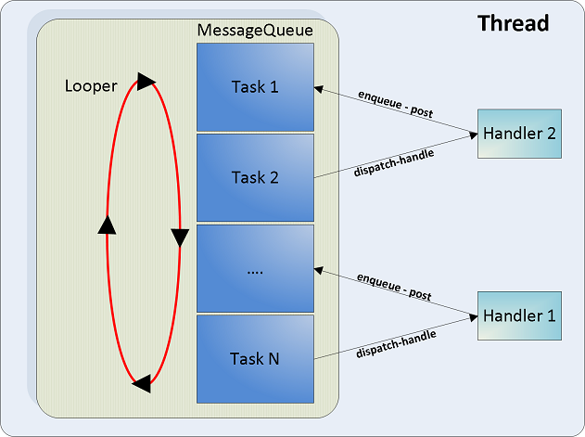
HandlerThreads. Architecture
HandlerThread = Thread + Looper + MessageQueue
Looper is a worker, that serves a MessageQueue for a current thread.
MessageQueue is a queue that has tasks called messages which should be processed.
Looper loops through this queue and sends messages to corresponding handlers to process.
Any thread can have only one unique Looper.
Handler is a class with 2 basic functions: post tasks to the MessageQueue and process them.

Slide 24
HandlerThreads. Looper and Handler.
Looper
Implements a message loop/queue/pump on a Thread
One Looper → One Thread
Looper logic:
Wait for work
Execute work
Goto 1
Handler
Schedules work on a Thread with a Looper
Messages may be scheduled
– A message is a data payload
– sendMessage(), sendMessageAtTime(), sendMessageDelayed()
– Handler should provide implementation for message actions
Runnables may be scheduled
– post(), postAtTime(), postDelayed()
One Handler → One Looper → One Thread
One Thread → One Looper → Multiple Handlers

Slide 25
HandlerThreads. Creation.
HandlerThread
Convenience class for:
– Starting a new Thread
– Creating a Looper on it
Once started, ready for new Handlers to give it work
HandlerThread handlerThread = new HandlerThread(“SomeName", priority);
handlerThread.start(); Looper looper = handlerThread.getLooper(); Handler handler = new CustomHandler(looper);
…
handlerThread.post(task);
… handlerThread.quit();

Slide 26
HandlerThreads. Pros and Cons.
Pros:
Easy to execute series of small tasks
API for task cancelation
Can be kept alive during a component lifecycle
Result of work can be easily published in UI thread
Cons:
Doesn’t handle configuration changes
Lots of code for small operations
When to use:
Series of small light-running operations where result should be published in UI thread
Better than managing Java Threads, better than AsyncTasks, but lots of code for small operations!

Slide 27
Approaches to work in Background. Services.

Slide 28
Services.
Service:
Is one of application components of Android
Need to be declared in AndroidManefest.xml
Usually used to do long-tern background work
Can interact with other component (exported = true)
Can (but not need to) run in another process
Is running in UI Thread
public class HelloService extends Service { @Override public void onCreate() {} @Override public int onStartCommand(Intent intent, int flags, int startId) {
return START_STICKY; } @Override public IBinder onBind(Intent intent) { return null; } @Override public void onDestroy() {} }

Slide 29
Services. Types.
Started
Services
Bound
Mixed

Slide 30
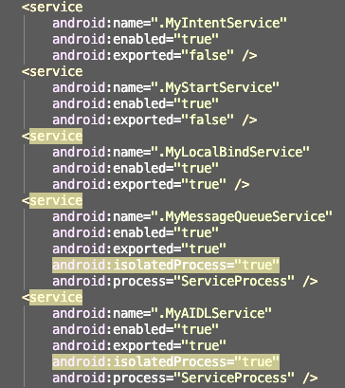
Service in AndroidManifest
android:name=“[package/service]”
android:enabled=“[true|false]”
android:exported=“[true|false]”
android:isolatedProcess=“[true|false]”
android:process=“[name/of/process]”

Slide 31
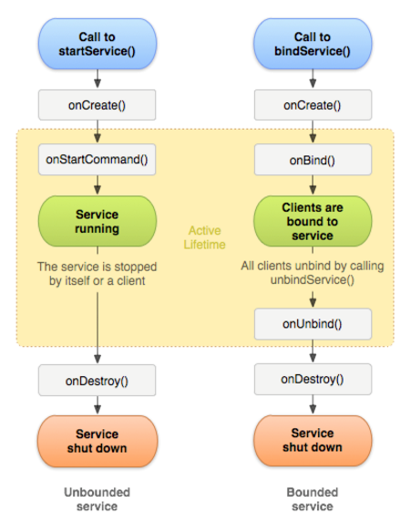
Services Lifecycle
Can be started/stopped several times, but only one instance. (implicit singleton)
No start/stop counting
Service can stop itself. (call Service.stopSelf())
If you need to start service for specified event, use Broadcast Receiver.

Slide 32
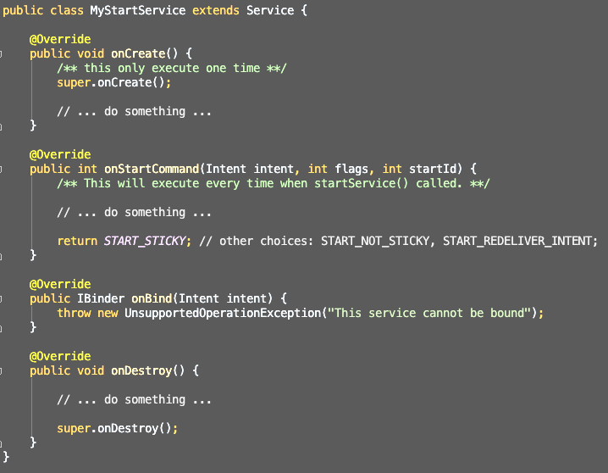
Started Service Sample

Slide 33
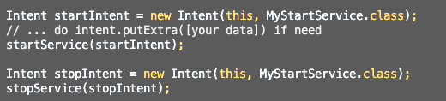
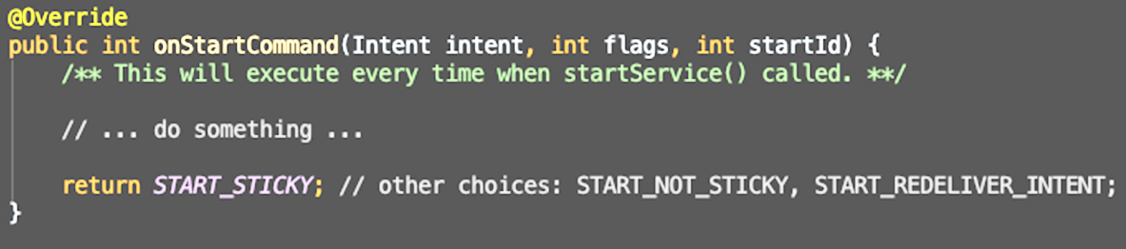
Start and Stop Service
Context.startService(Intent)
Context.stopService(Intent)
Service.stopSelf()
The return value define the behavior of service:
return START_STICKY
return START_NOT_STICKY
return START_REDELIVER_INTENT
flag: START_FLAG_REDELIVERY, START_FLAG_RETRY

Slide 34
Bound Service
A service can be bind several times. And service will maintain a bindCount
When someone bind service, bindCount + 1
When someone unbind service, bindCount - 1
Service destroy itself when bindCount == 0

Slide 35

Context.bindService()
bindService(Intent, ServiceConnection, int flags);
flags: BIND_AUTO_CREATE BIND_NOT_FOREGROUND BIND_ABOVE_CLIENT BIND_ALLOW_OOM_MANAGEMENT BIND_WAIVE_PRIORITY

Slide 36
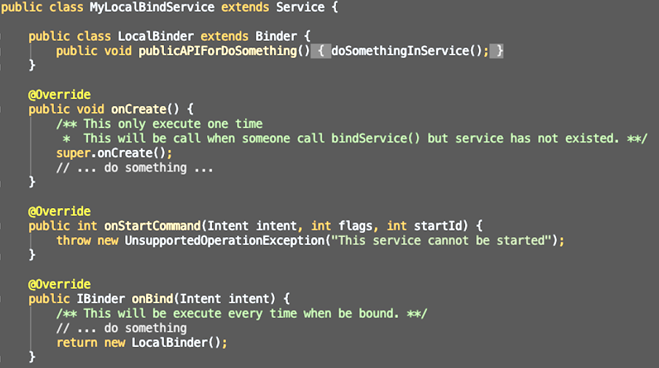
Bound Service Sample (service)

Slide 37
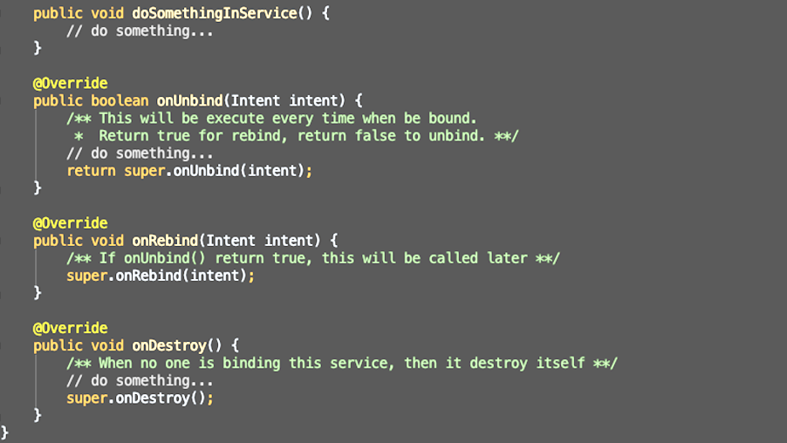
Bound Service Sample (service)

Slide 38
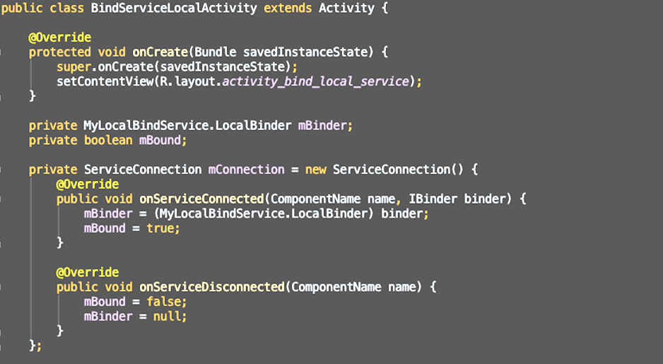
Bound Service Sample (Activity)

Slide 39
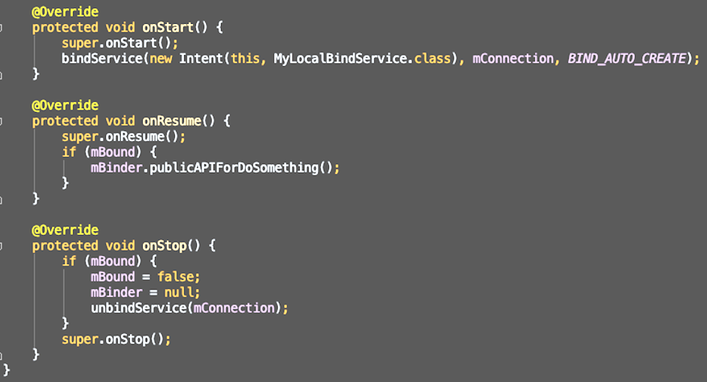
Bound Service Sample (Activity)
Sample: LocalService

Slide 40
InterProcess Communication (IPC). Messenger
Since the service is run in another process, we can not call its function directly
Solutions:
Messenger: simple, but the calling order is not guarantee
AIDL: Hard to implement, guarantee the calling order
https://developer.android.com/guide/components/aidl.html
Sample: RemoteService + ServiceApp
Messenger:
Create a Handler to receive commands
Create a Messenger and use Handler
return Messenger.getBinder() in onBind()

Slide 41
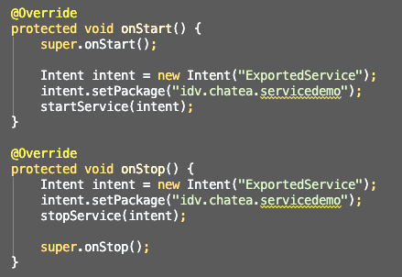
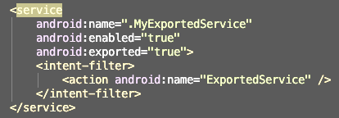
Exported Services
Exported Service make you use other application’s service
The exported service is run in the process of its application, NOT in the process of caller
If used as bound service, the binder of it should support IPC (thus, it usually used with AIDL.)

Slide 42
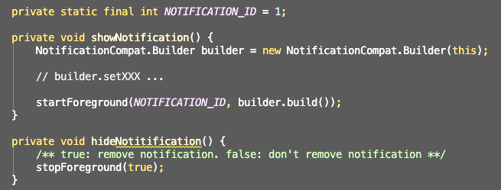
Notifications
Notification is part of Service
Use NotificationCompat.Builder
startForeground(int notificationId, Notification) # the notificationId must NOT be 0
startForeground with same id will replace the previous notification which has same id.

Slide 43
IntentServices.
It is implemented to do something in non-UI thread.
we only need to implement the WorkerThread
It only execute one at time (queueing)
It uses HandlerThread
It will stop when completed
public class HelloIntentService extends IntentService { /** * A constructor is required * constructor with a name for the worker thread. */ public HelloIntentService() { super("HelloIntentService"); } @Override protected void onHandleIntent(Intent intent) { // Normally we would do some work here, like download a file.
}
}
Sample: IntentService

Slide 44
Services. Typical Issues.
Typical issues:
Execution in UI thread
How to update UI?
Lots of code for one operation, no pull for series
Solutions:
External process or Service + Handler + Looper or IntentService
Service + Handler + Looper or use LocalBroadcastManager
Don’t use for small one-time operations, implement pull through Handler + Looper or IntentService

Slide 45
Services. Pros and Cons.
Pros:
The most flexible solution
Tasks execute independently of activity lifecycle
The execution can easily be shared between multiple clients
Can be triggered via Intents, through method calls, or across processes via IPC
Cons:
Can be a bit complicated
When to use:
Must continue beyond the Activity that initiated it
May be started at any time and may run indefinitely
Large background uploads, downloads, data refresh, sync
Lengthy computation
Background media playback
Other background operations that the user should be aware of

Slide 46
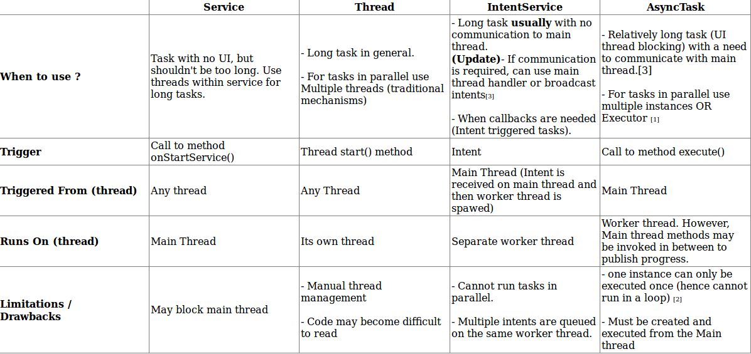
What should I use?

Slide 47
Networking. REST API.

Slide 48
REST API. Why to use 3rd party libs?
Asynchronous request execution
Connection pooling
Request interruption
Caching
Automatic data conversion and parsing
Support for SPDY, HTTP/2
Simple request implementation

Slide 49
REST API. Libs to check
Volley
https://github.com/google/volley
Retrofit
https://github.com/square/retrofit

Slide 50
REST API. Volley Request Scheme
add to queue
respose deliver on main thread
dequeued by CacheDispatcher
Cache hit
response read from cache and parse
Cache miss
dequeued by NetworkDispatcher
HTTP transaction,
respose parse,
cache write
dequeued by NetworkDispatcher
dequeued by NetworkDispatcher

Slide 51
REST API. Volley Request
RequestQueue queue = Volley.newRequestQueue(ctx);
StringRequest request = new StringRequest( Request.Method.GET, url, new Response.Listener<String>() { @Override public void onResponse(String response) {} }, new Response.ErrorListener() { @Override public void onErrorResponse(VolleyError error) {} } );
request.setTag(TAG); queue.add(request);
Self-Sample: http://www.jsontest.com/#ip
https://www.journaldev.com/2321/gson-example-tutorial-parse-json#gson-example

Slide 52
REST API. Retrofit Library
Retrofit is a REST Client for Android and Java by Square. It makes it relatively easy to retrieve and upload JSON (or other structured data) via a REST based webservice. In Retrofit you configure which converter is used for the data serialization. Typically for JSON you use GSon, but you can add custom converters to process XML or other protocols. Retrofit uses the OkHttp library for HTTP requests.
To work with Retrofit you need basically three classes.
Model class which is used to map the JSON data to
Interfaces which defines the possible HTTP operations
Retrofit.Builder class - Instance which uses the interface and the Builder API which allows defining the URL end point for the HTTP operation.

Slide 53
REST API. Retrofit. Installation.
The source code to the Retrofit, its samples, and this website is available on GitHub:
https://github.com/square/retrofit
MAVEN
<dependency>
<groupId>com.squareup.retrofit2</groupId>
<artifactId>retrofit</artifactId>
<version>2.3.0</version>
</dependency>
GRADLE
compile 'com.squareup.retrofit2:retrofit:2.3.0'
Retrofit requires at minimum Java 7 or Android 2.3.

Slide 54
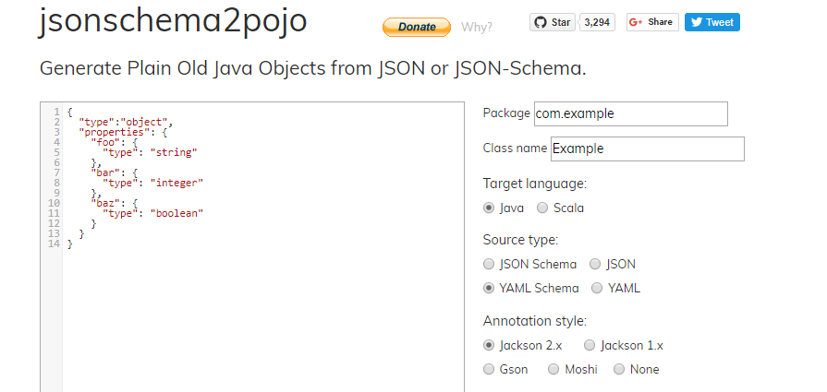
REST API. Retrofit. Model class.
You can generate Java objects based on JSON via the following URL: http://www.jsonschema2pojo.org/
This can be useful to create complex Java data structures from existing JSON.

Slide 55
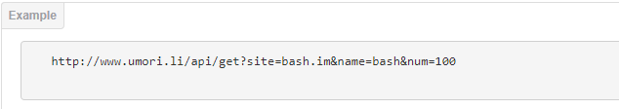
REST API. Retrofit. Interfaces
Retrofit turns your HTTP API into a Java interface.
public interface UmoriliApi {
@GET("/api/get")
Call<List<PostModel>> getData(@Query ("site") String siteName, @Query("name") String resourceName,
@Query("num") int count);
}
Every method of an interface represents one possible API call. It must have a HTTP annotation (GET, POST, etc.) to specify the request type and the relative URL. The return value wraps the response in a Call object with the type of the expected result.

Slide 56
REST API. Retrofit. URL Manipulation.
URL MANIPULATION
A request URL can be updated dynamically using replacement blocks and parameters on the method. A replacement block is an alphanumeric string surrounded by { and }. A corresponding parameter must be annotated with @Path using the same string.
@GET("group/{id}/users")
Call<List<User>> groupList(@Path("id") int groupId);
Query parameters can also be added.
@GET("group/{id}/users")
Call<List<User>> groupList(@Path("id") int groupId, @Query("sort") String sort);
For complex query parameter combinations a Map can be used.
@GET("group/{id}/users")
Call<List<User>> groupList(@Path("id") int groupId, @QueryMap Map<String, String> options);

Slide 57
REST API. Retrofit. Request Body.
REQUEST BODY
An object can be specified for use as an HTTP request body with the @Body annotation.
@POST("users/new")
Call<User> createUser(@Body User user);
The object will also be converted using a converter specified on the Retrofit instance. If no converter is added, only RequestBody can be used.

Slide 58
REST API. Retrofit. Implementation
The Retrofit class generates an implementation of the UmoriliApi interface.
public class App extends Application {
private static UmoriliApi umoriliApi;
private Retrofit retrofit;
@Override
public void onCreate() {
super.onCreate();
retrofit = new Retrofit.Builder()
.baseUrl("http://umorili.herokuapp.com")
.addConverterFactory(GsonConverterFactory.create())
.build();
umoriliApi = retrofit.create(UmoriliApi.class);
}
public static UmoriliApi getApi() {
return umoriliApi;
}
}
Each Call from the created object can make a synchronous or asynchronous HTTP request to the remote webserver.

Slide 59
REST API. Retrofit. Synchronous calls
Synchronous methods are executed on the main thread. That means the UI blocks during request execution and no interaction is possible for this period.
Warning: synchronous requests trigger app crashes on Android 4.0 or newer. You’ll run into the `NetworkOnMainThreadException` error.
Synchronous methods provide the ability to use the return value directly, because the operation blocks everything else during your network request.
For non-blocking UI, you have to handle the request execution in a separated thread by yourself. That means, you can still interact with the app itself while waiting for the response.
Using the .execute() method on a call object will perform the synchronous request in Retrofit 2. The deserialized response body is available via the .body() method on the response object.
Response response = App.getApi().getData("bash", 50).execute();

Slide 60
REST API. Retrofit. Asynchronous calls
Retrofit performs and handles the method execution in a separated thread. The Callback class is generic and maps your defined return type. Using asynchronous requests forces you to implement a Callback with its two callback methods: success and failure. The following code snippet illustrates an exemplary implementation.
App.getApi().getData("bash.im","bash", 50).enqueue(new Callback<List<PostModel>>() {
@Override
public void onResponse(Call<List<PostModel>> call, Response<List<PostModel>> response) {
posts.addAll(response.body());
recyclerView.getAdapter().notifyDataSetChanged();
}
@Override
public void onFailure(Call<List<PostModel>> call, Throwable t) {
Toast.makeText(MainActivity.this, "An error occurred during networking", Toast.LENGTH_SHORT).show();
}
});

Slide 61
REST API. Retrofit. Converters.
Retrofit is the class through which your API interfaces are turned into callable objects. By default, Retrofit will give you sane defaults for your platform but it allows for customization.
CONVERTERS
By default, Retrofit can only deserialize HTTP bodies into OkHttp's ResponseBody type and it can only accept its RequestBody type for @Body.
Converters can be added to support other types. Six sibling modules adapt popular serialization libraries for your convenience.
Gson: com.squareup.retrofit2:converter-gson
Jackson: com.squareup.retrofit2:converter-jackson
Moshi: com.squareup.retrofit2:converter-moshi
Protobuf: com.squareup.retrofit2:converter-protobuf
Wire: com.squareup.retrofit2:converter-wire
Simple XML: com.squareup.retrofit2:converter-simplexml
Scalars (primitives, boxed, and String): com.squareup.retrofit2:converter-scalars

Slide 62
REST API. Retrofit. Converters.
CUSTOM CONVERTERS
If you need to communicate with an API that uses a content-format that Retrofit does not support out of the box (e.g. YAML, txt, custom format) or you wish to use a different library to implement an existing format, you can easily create your own converter. Create a class that extends the Converter.Factory class and pass in an instance when building your adapter.

Slide 63
Retrofit. Pros and Cons.
Pros:
Super easy to use
Minimal boilerplate coding
Easy to read
Easy to make changes
Lightweight - no-frills and gets out of the way
Cons:
Lack of control over URL generation
No request caching

Slide 64
REST API. Retrofit vs Volley
 | Retrofit | Volley
Integration | compile 'com.squareup.retrofit2:retrofit:2.3.0‘ | compile 'com.android.volley:volley:1.0.0'
Sync / Async requests | Yes / Yes | Not trivial / Yes
Data parsers | XML, JSON, ProtoBuf, Scalars + Custom | JSON, String + Custom
Dynamic links | Yes | No
Request interruption | Yes, since 2.0 | Yes
HttpClient | OkHttp + Custom | HttpURLConnection + Custom

Slide 65
REST API. Retrofit vs Volley
 | Retrofit | Volley
Caching | Yes, via OkHttp | Yes
Request repeat by timeout | Yes, via OkHttp | Yes
Request description | Based on annotations | In source code
Documentation | Well documented | Moderately documented
Image Loading | No | Yes
Rx | Yes | No

